Slide 1
RHIPS – Extended™
By: Zackery Painter – Team 1f
Csse 232 – Computer architecture 1 – winter 2021

Slide 2
Architecture overview
Load-Store
Multicycle
16-bit datapath
16-bit addresses
4-bit register addresses
16-bit data bus
32 registers

Slide 3
Instruction set overview
Notes:
16-bit instructions – 4bit opcode
R-type
I-type
Ext-type – 2 opcodes – 8 ext codes total of 16 extra instructions

Slide 4
Instruction set overview

Slide 5
Special instructions
Term
Terminate the current program
State 256
Wait for start interrupt
Syscall
Calls a software interrupt
Cmp / Ccp
Copy data between kernel and main registers

Slide 6
rtl

Slide 7
FSM

Slide 8
Final Datapath – with kernel support

Slide 9
Final Datapath -A

Slide 10
Final Datapath – b and c

Slide 11
Final datapath - d

Slide 12
Testing
Unit testing
Run full tests on each component individually
Implementation Testing
Divide into 5 sections
Combine into 3 sections
Combine into entire data path with control

Slide 13
Timing
Total Cycles to run Relprime: 949,377 cycles
Total Instructions: 46,748
Minimum period: 25.162ns
Maximum frequency: 39.742MHz

Slide 14
Extras - assembler
Auto-assemble
Looks for changes in the file and automatically assembles when detected
Auto-kernel splice
Gives the option to splice a pre-assembled kernel into the output of the current assembly file
Side-by-side view
Provides an assembled version next to the non-assembled version

Slide 15
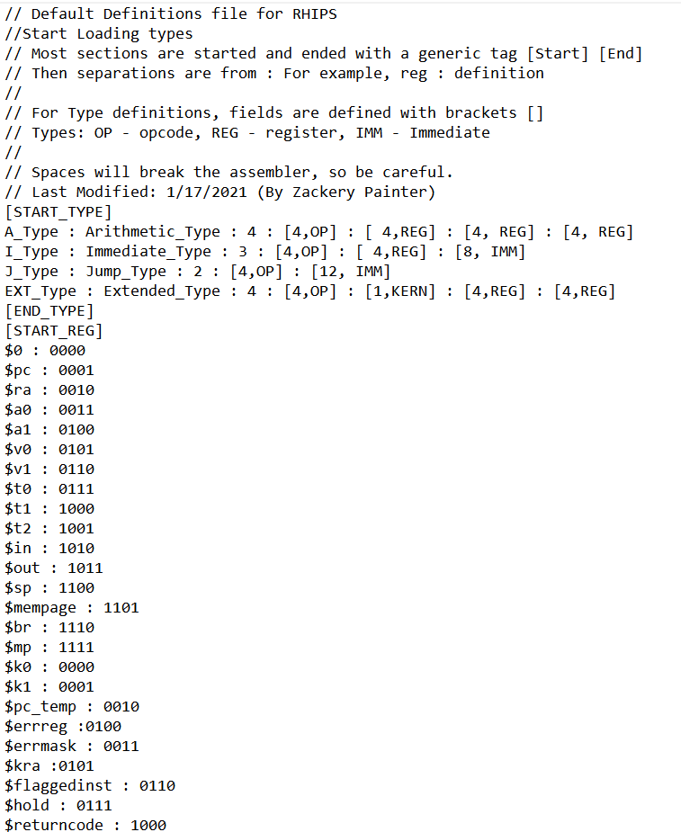
Extras - Assembler

Slide 16
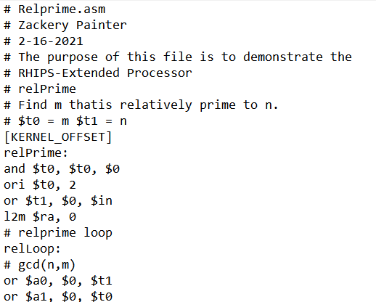
Extras - assembler

Slide 17
extras – (partial) kernel
Handle basic interrupts
Invalid address – Terminate Processor
Start Execution at main loop
Provide idle loop
Waits in an idle loop until a start interrupt is received
Planned interrupts (incomplete):
Access violation
User tried to access kernel protected memory
Arithmetic overflow
Overflow during ALU operation
Invalid instruction
Skip invalid instructions

Slide 18
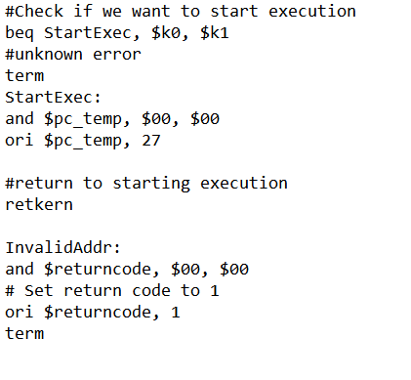
extras – (partial) kernel

Slide 19
Changes I want to make
Change branch logic
Combine FSM States
Write more kernel code
FPGA implementation

